Slide 1

Museum of Contemporary Art

Slide 2
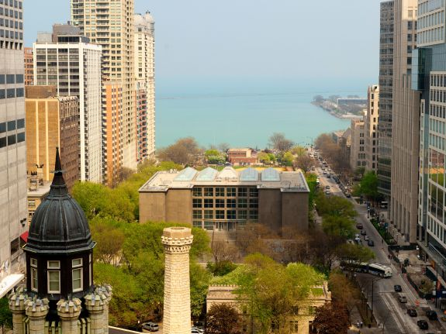

Bird’s eye view of the building overlooking Michigan Lake.

Slide 3
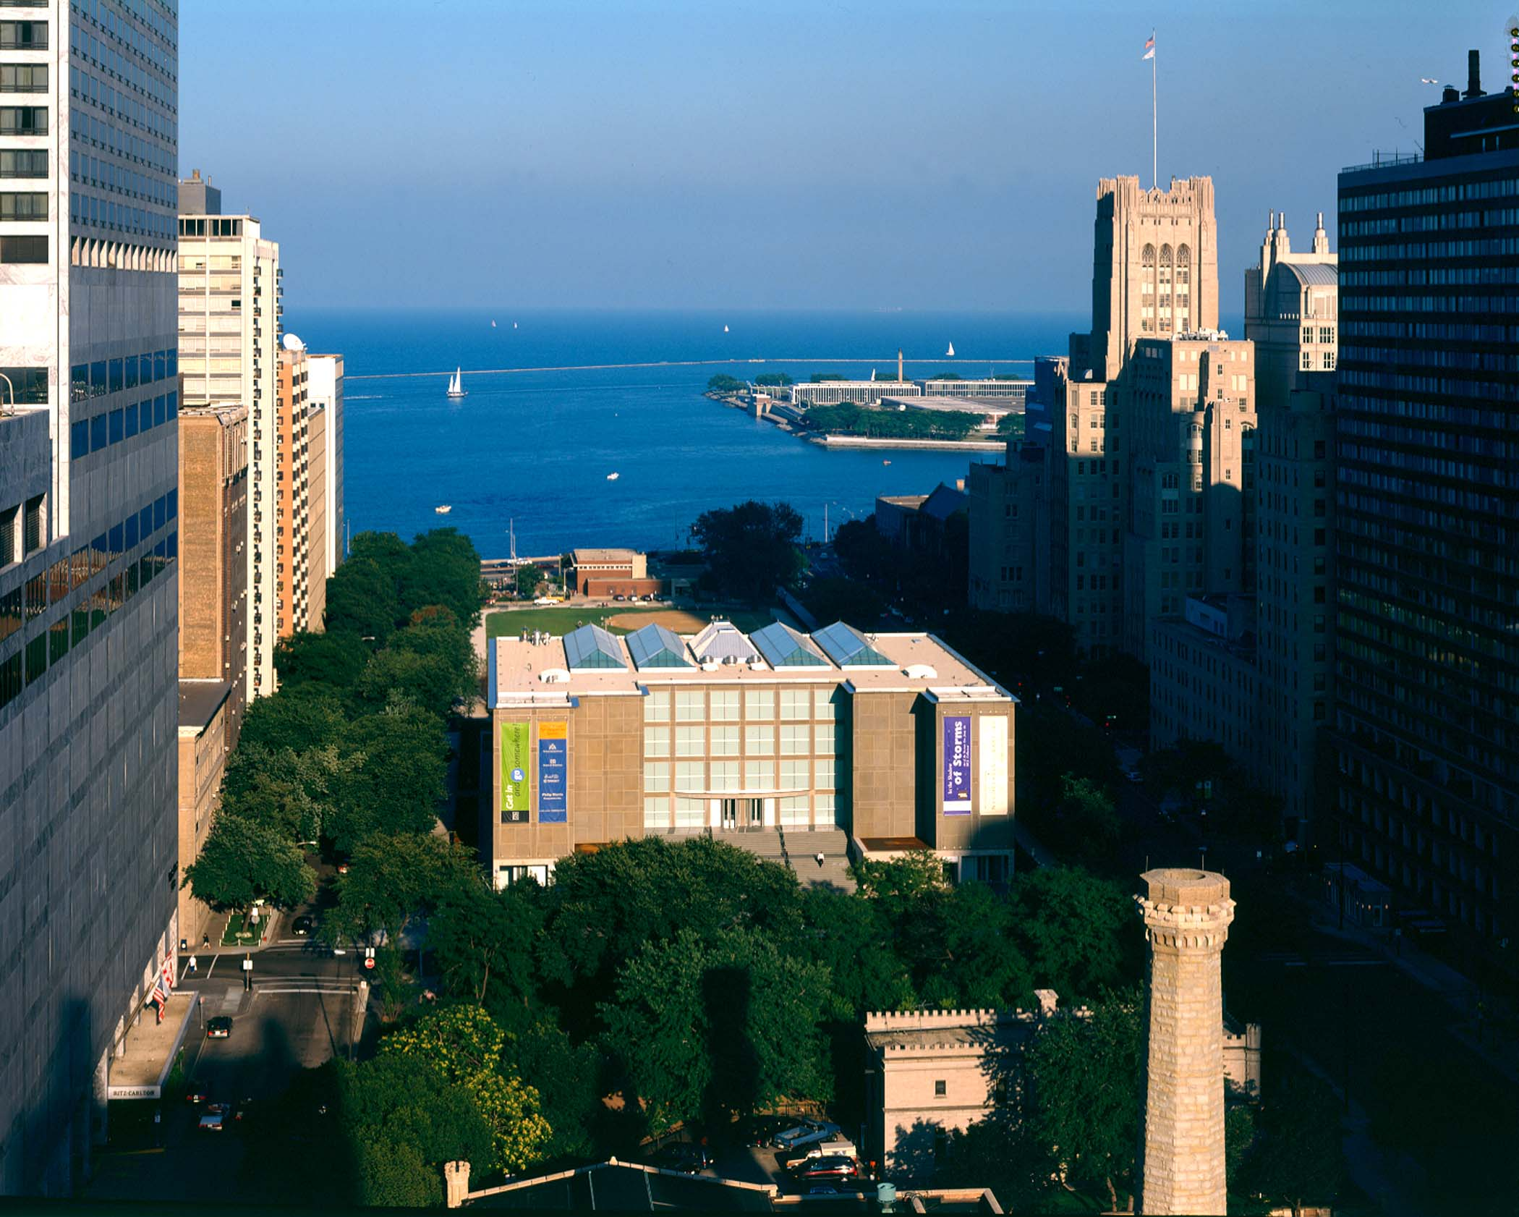
MCA holds Conferences and Art shows.

Slide 4
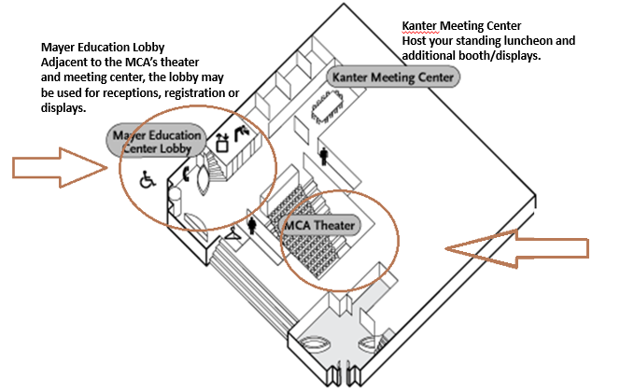
MCA Theater
Our 300 seat, state of the art
theater gives each of your
guests the best seat in the house

Slide 5
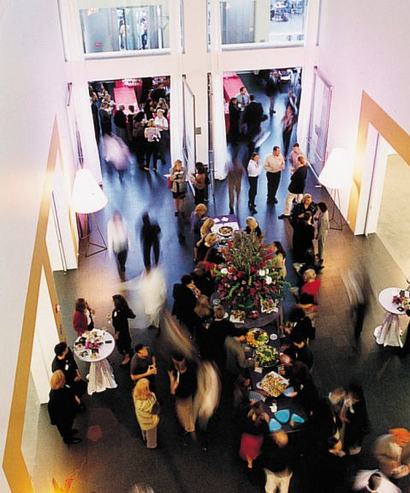
Mayer Education Lobby

Slide 6
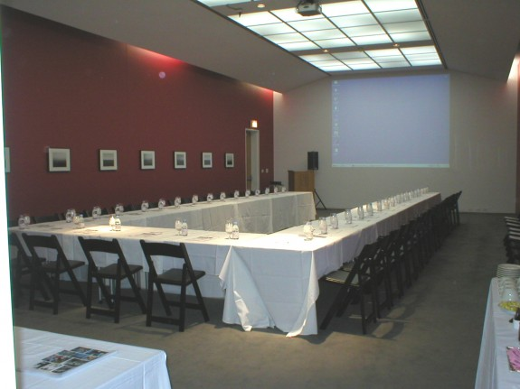
Kanter Specifications
1,200 square feet
Capacity: 100 reception/60 seated
Equipped with overhead projector
Adjacent to Edlis Neeson Theater
This picture will give you an idea of the space.
Standing Luncheon will be held.

Slide 7
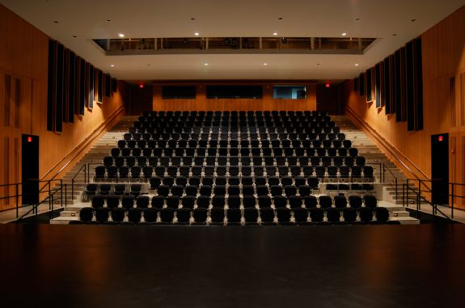
Theater Specifications
The facility provides seating for 296 persons and is wheelchair-accessible.
Rental includes basic audiovisual and lighting package
14 rows with two side aisles and no center aisle
Motorized projection screen provides a projection surface of 30′ wide and 23′ high. The screen is located at an intermediate stage depth, so that good sightlines are available from front row seats.
Stage dimensions: Width of opening: 52′ (15.8 m); Total depth: 34′ (10.3 m); Wing space (each side): 13′ (3.9 m)
Stage height is 36″ above the floor level of the first row of seating

Slide 8
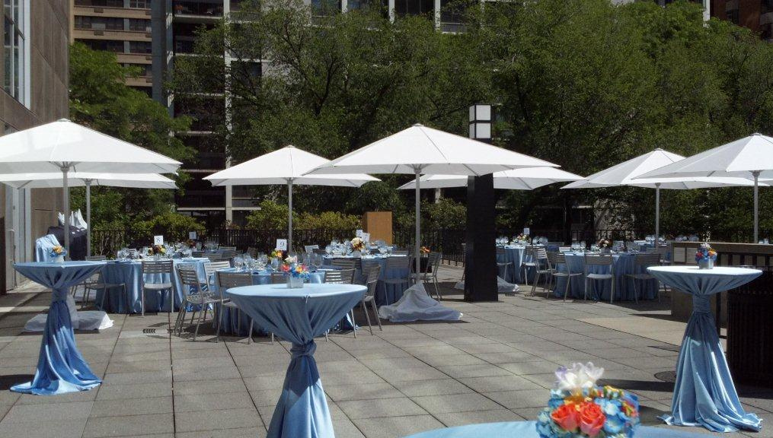
MCA Terrace

Slide 9
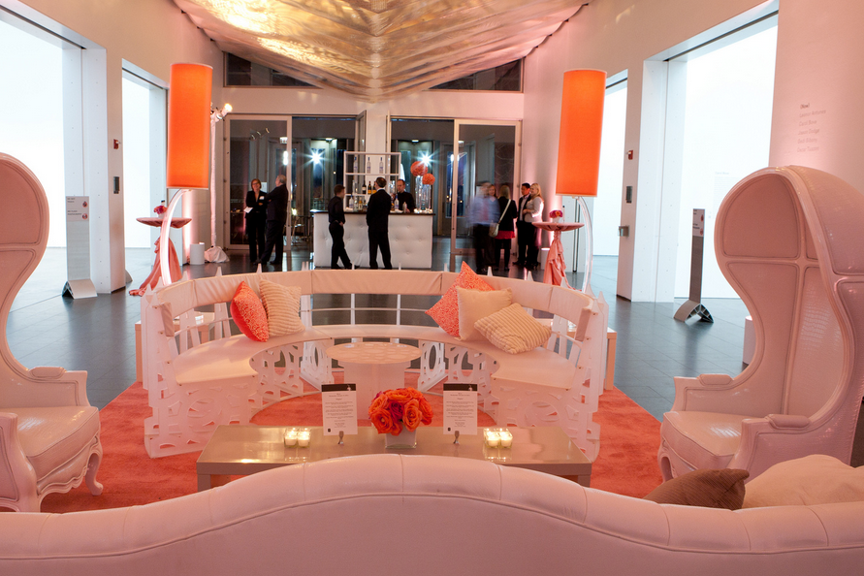
One of the events set up in MCA

Slide 10
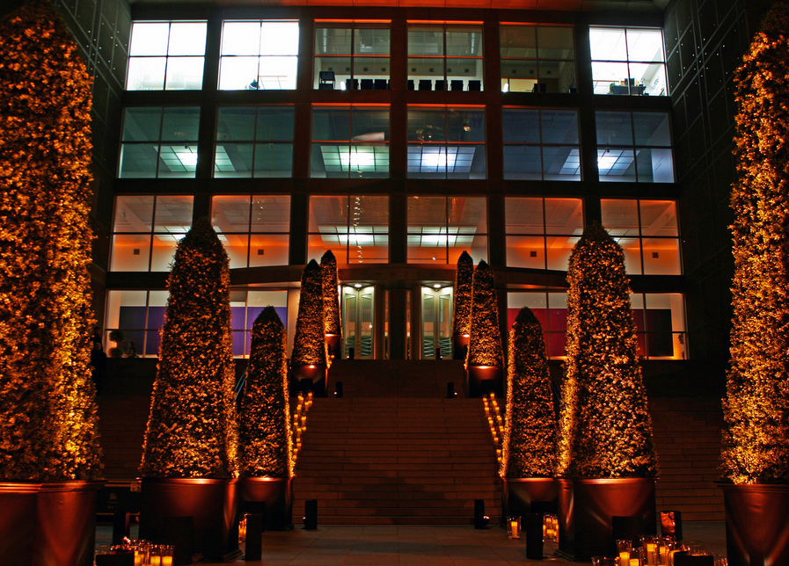
MCA Entrance

Slide 11
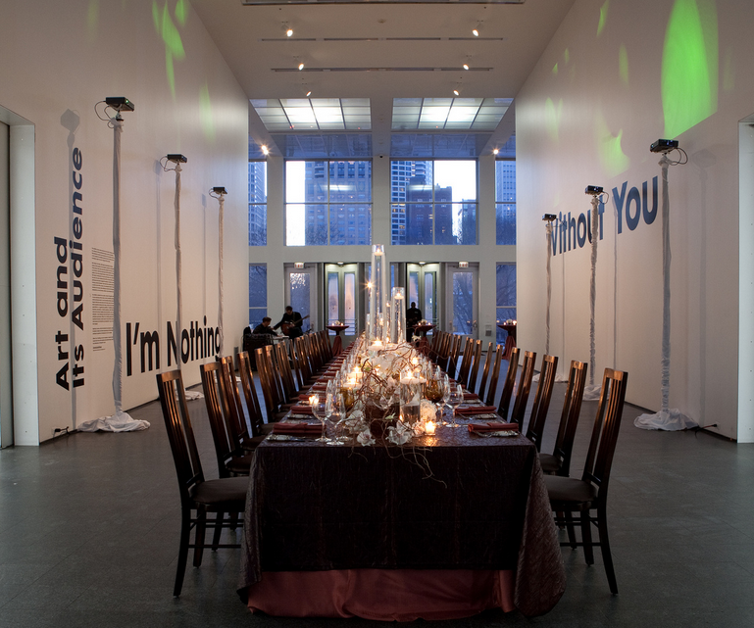
MCA Indoor

Slide 12
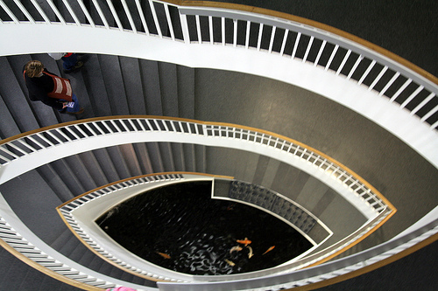
Example modern design of MCA

Slide 13
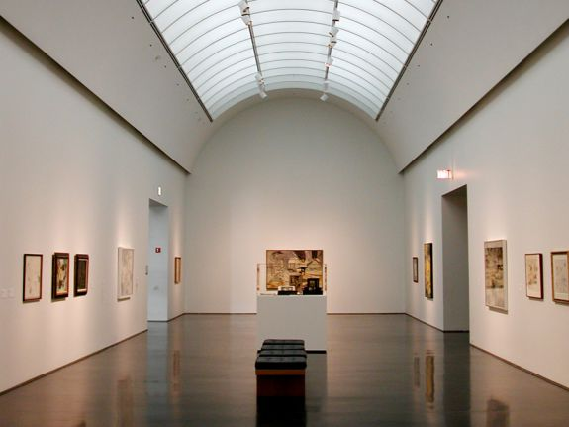
One of the nation’s largest facilities devoted to the art of our time, the Museum of Contemporary Art Chicago offers exhibitions of the most thought-provoking art created since 1945

Slide 14
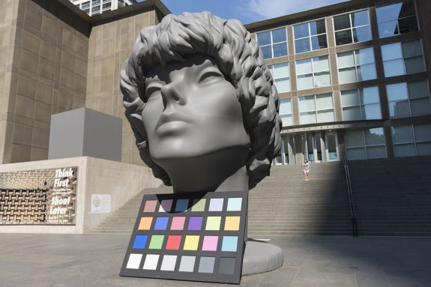

Slide 15
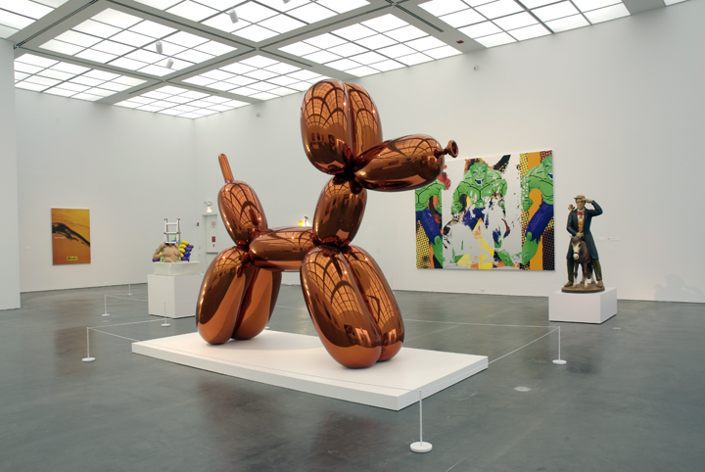
Attendees will be free to wander around the exposition floors.

Slide 16
CHICAGO
Ritz-Carlton – A Four Season Hotel

Slide 17
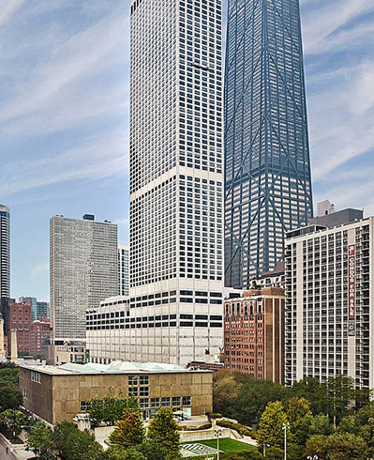
Ritz-Carlton Chicago
Raffaello
Museum of Contemporary of Art

Slide 18
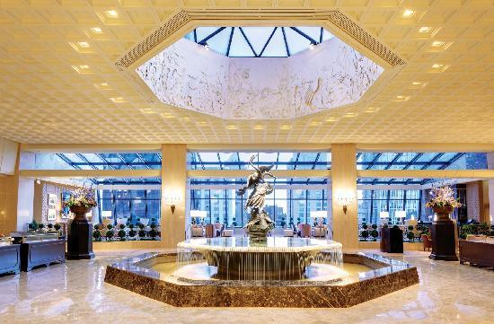
Ritz-Carlton Chicago Lobby

Slide 19
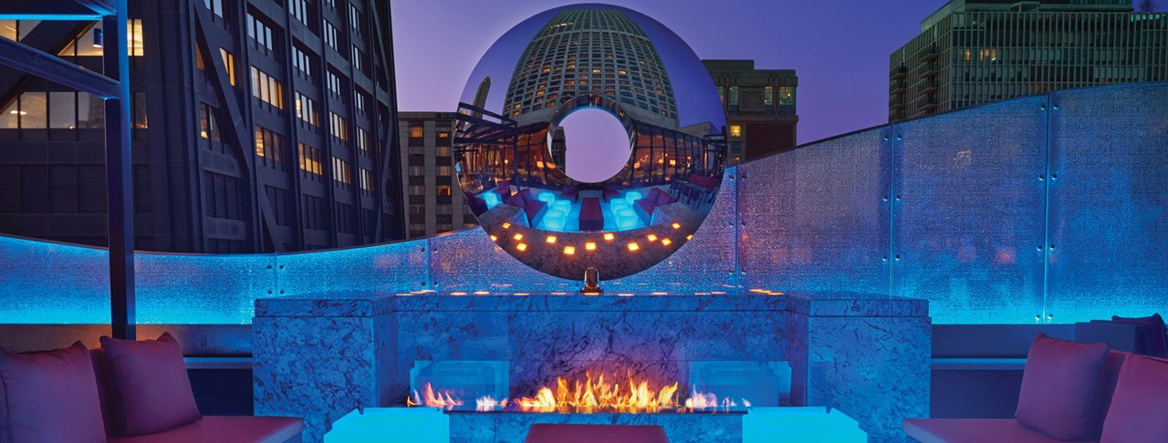

Slide 20
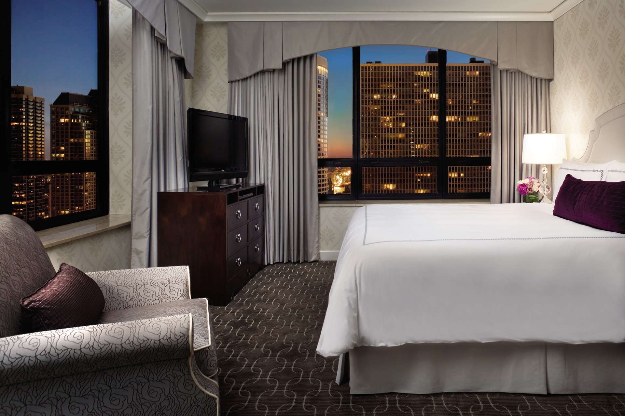

Slide 21
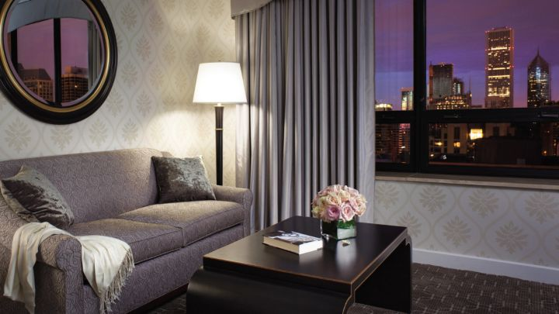

Slide 22
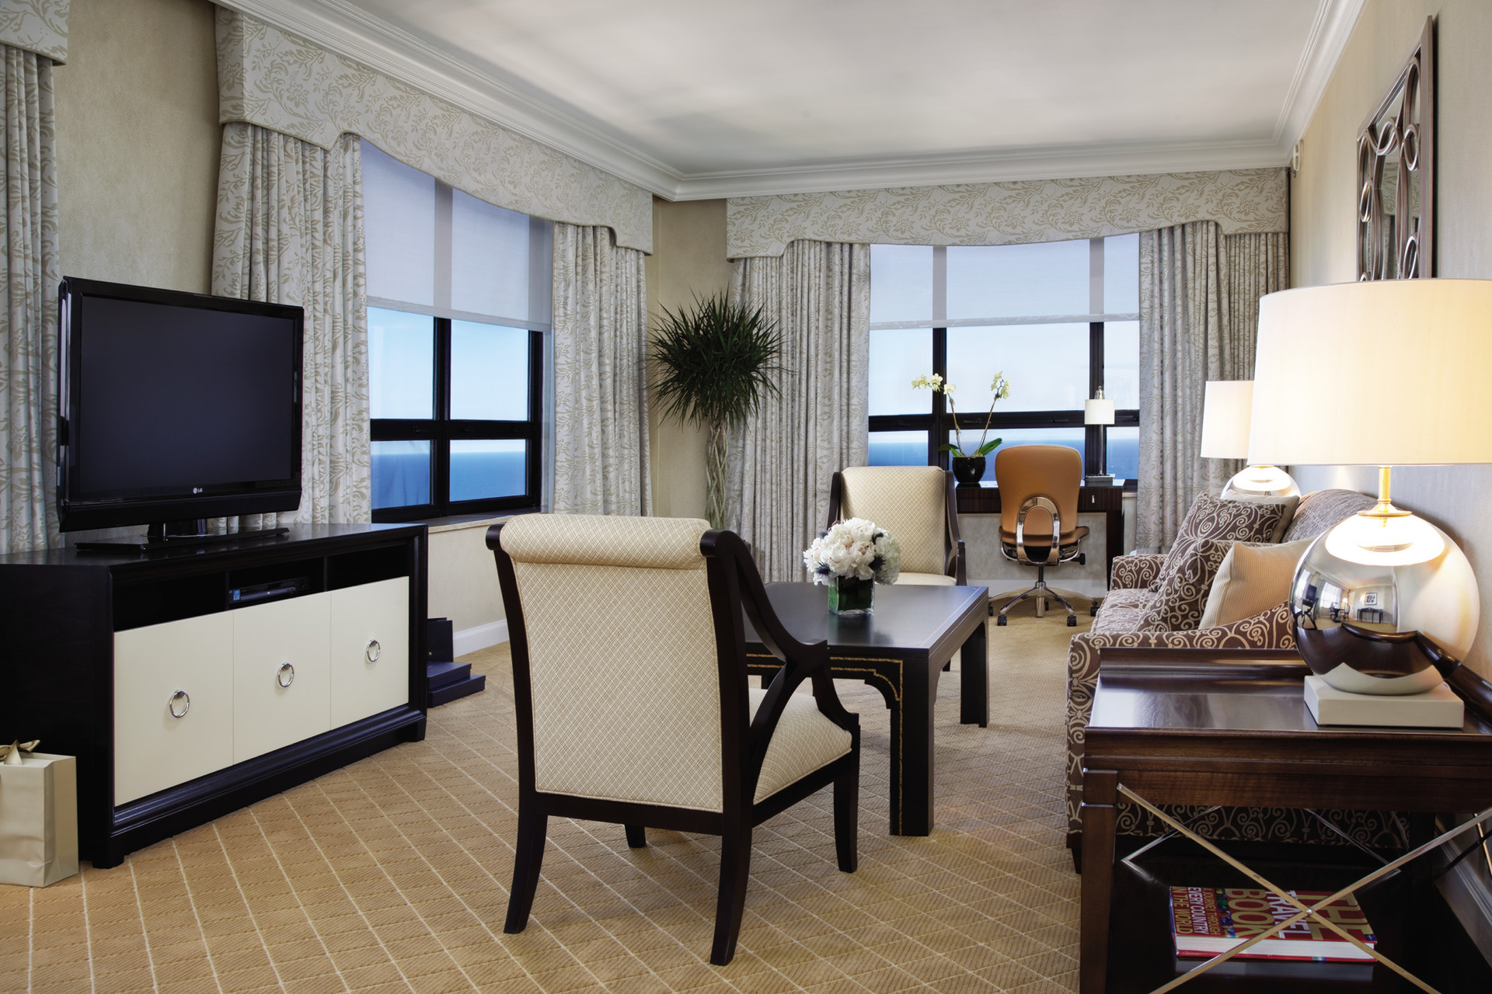

Slide 23
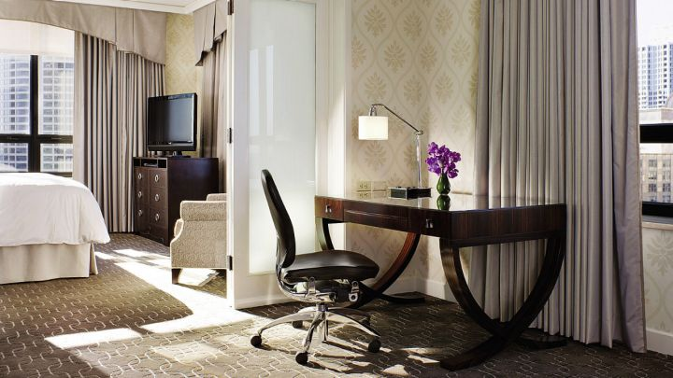

Slide 24
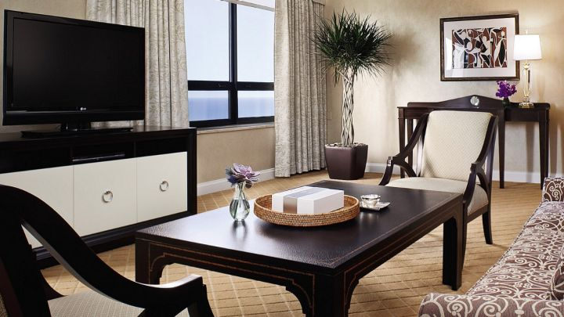

Slide 25
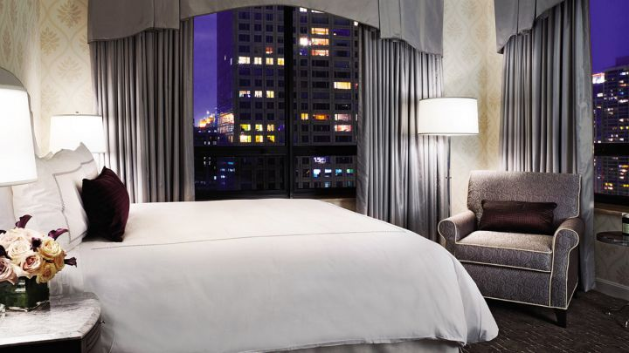

Slide 26
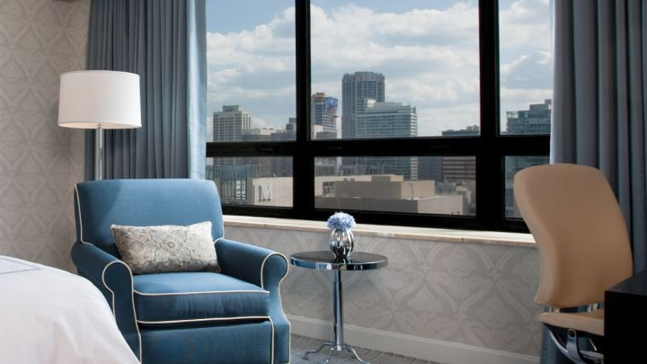

Slide 27
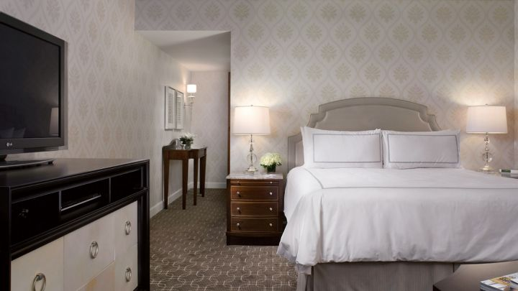

Slide 28
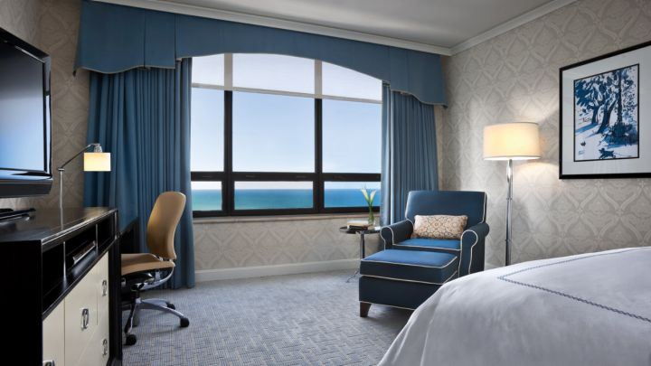

Slide 29
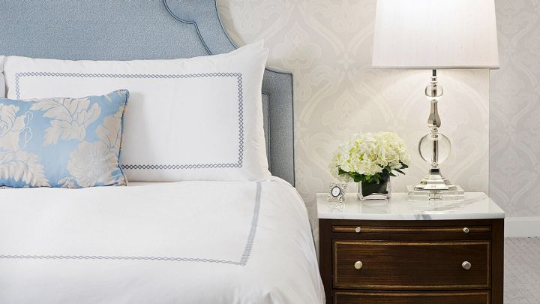

Slide 30
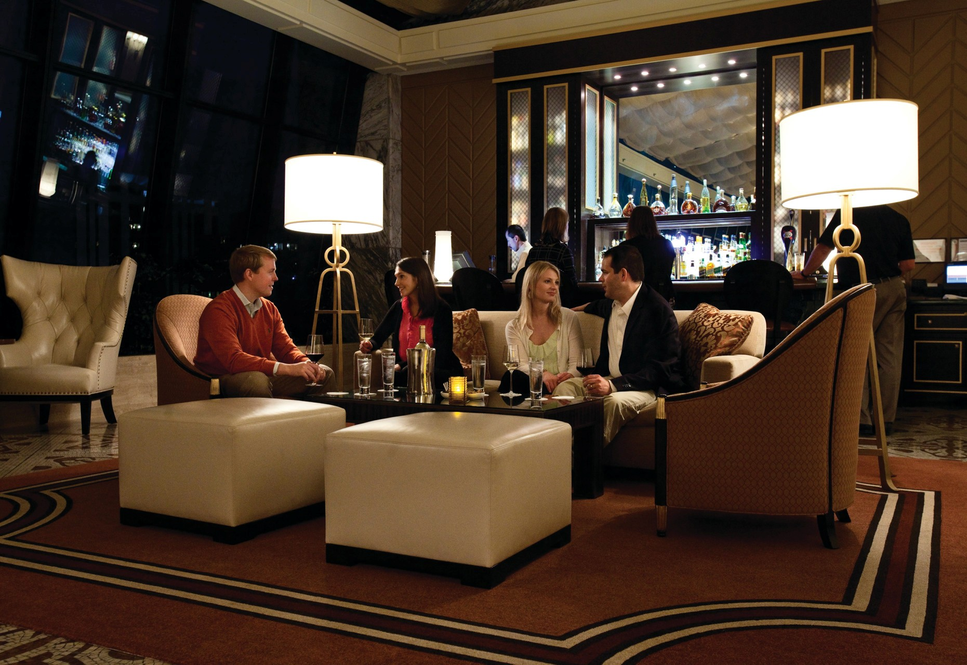

Slide 31
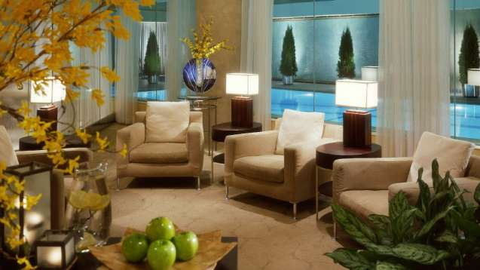

Slide 32
Raffaello

Slide 33
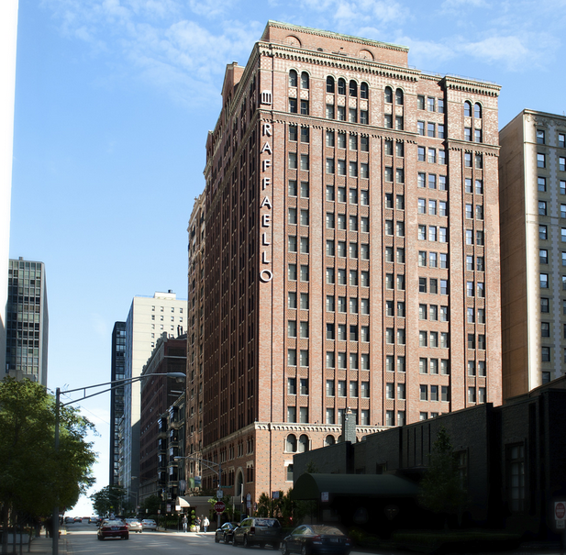

Slide 34
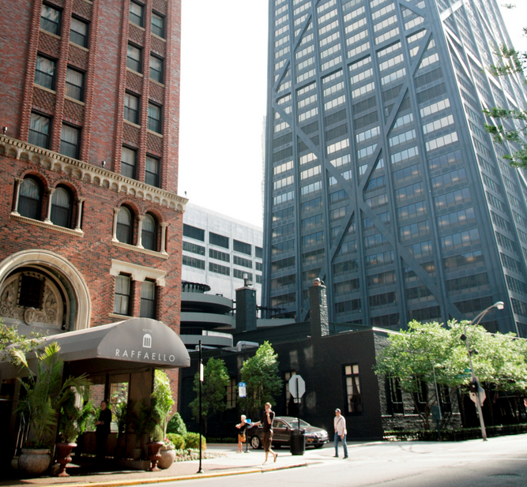

Slide 35
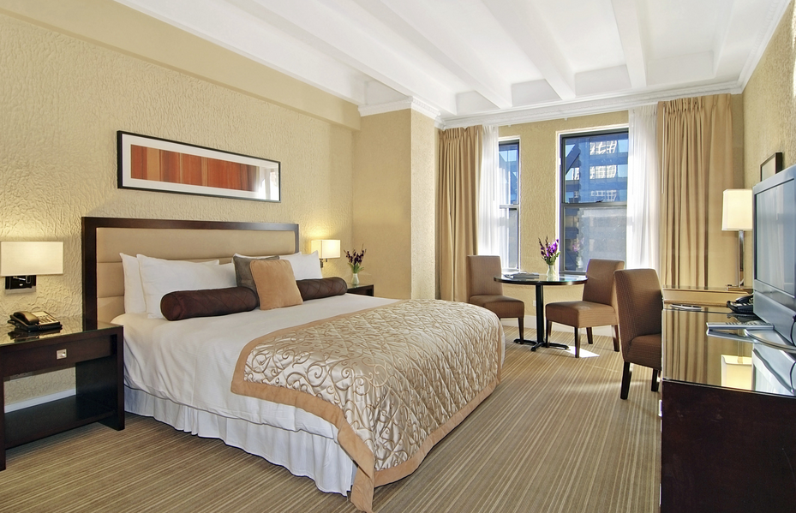

Slide 36
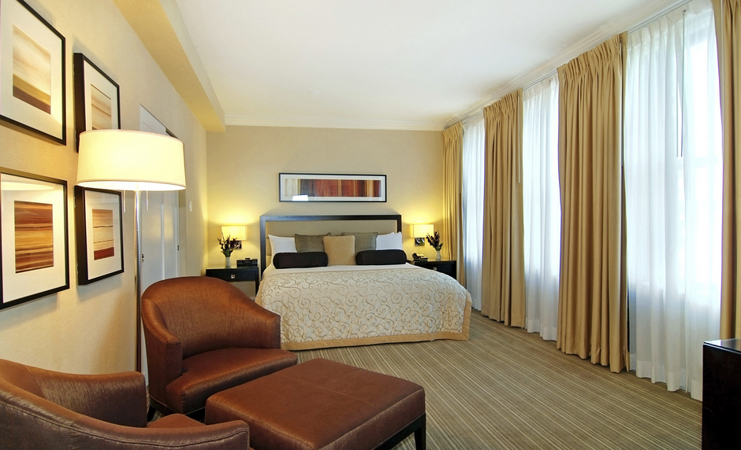

Slide 37
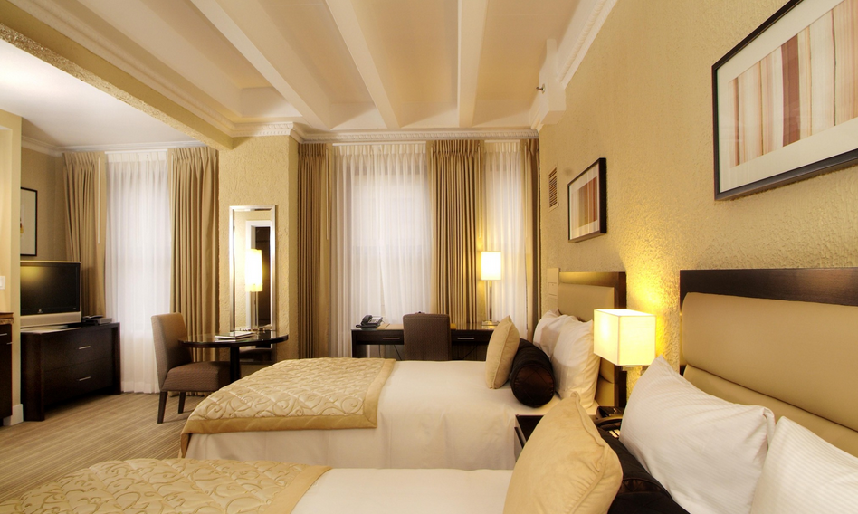

Slide 38
